Slide 1

COMPUTER NETWORKS
Sivaraman Eswaran Ph.D.
Department of Computer Science and Engineering

Slide 2

COMPUTER NETWORKS
Application Layer
Sivaraman Eswaran Ph.D.
Department of Computer Science and Engineering

Slide 3
COMPUTER NETWORKS
Unit – 2 Application Layer
2.1 Principles of Network Applications
2.2 Web, HTTP and HTTPS
2.3 The Domain Name System
2.4 P2P Applications
2.5 Socket Programming with TCP & UDP
2.6 Other Application Layer Protocols

Slide 4
COMPUTER NETWORKS
HTTP Request Message
two types of HTTP messages: request, response
HTTP request message:
ASCII (human-readable format)
carriage return character
line-feed character
request line (GET, POST,
HEAD commands)
GET /index.html HTTP/1.1\r\n
Host: www-net.cs.umass.edu\r\n
User-Agent: Firefox/3.6.10\r\n
Accept: text/html,application/xhtml+xml\r\n
Accept-Language: en-us,en;q=0.5\r\n
Accept-Encoding: gzip,deflate\r\n
Accept-Charset: ISO-8859-1,utf-8;q=0.7\r\n
Keep-Alive: 115\r\n
Connection: keep-alive\r\n
\r\n
header
lines
carriage return, line feed at start of line indicates end of header lines
* Check out the online interactive exercises for more examples: http://gaia.cs.umass.edu/kurose_ross/interactive/

Slide 5
COMPUTER NETWORKS
HTTP Request Message: General Format
method
sp
URL
sp
version
cr
lf
request
line
header field name
value
cr
lf
~
~
header
lines
~
~
header field name
value
cr
lf
cr
lf
~
entity body
~
body
~
~
HTTP specifications [RFC 1945; RFC 2616; RFC 7540]

Slide 6
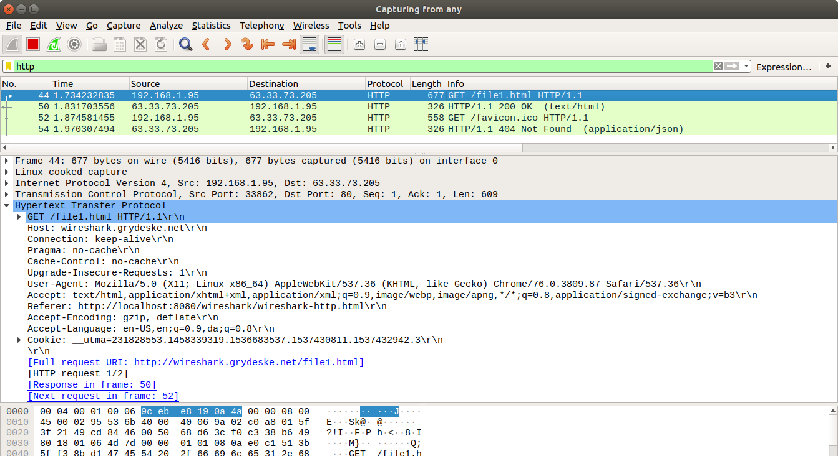
COMPUTER NETWORKS
HTTP Request Message – Wireshark Capture

Slide 7
COMPUTER NETWORKS
Other HTTP Request Messages
POST method:
web page often includes form input
user input sent from client to server in entity body of HTTP POST request message
HEAD method:
requests headers (only) that would be returned if specified URL were requested with an HTTP GET method.
GET method (for sending data to server):
include user data in URL field of HTTP GET request message (following a ‘?’):
PUT method:
uploads new file (object) to server
completely replaces file that exists at specified URL with content in entity body of POST HTTP request message
www.somesite.com/animalsearch?monkeys&banana

Slide 8
COMPUTER NETWORKS
HTTP Response Message
status line (protocol
status code status phrase)
HTTP/1.1 200 OK\r\n
Date: Sun, 26 Sep 2010 20:09:20 GMT\r\n
Server: Apache/2.0.52 (CentOS)\r\n
Last-Modified: Tue, 30 Oct 2007 17:00:02 GMT\r\n
ETag: "17dc6-a5c-bf716880"\r\n
Accept-Ranges: bytes\r\n
Content-Length: 2652\r\n
Keep-Alive: timeout=10, max=100\r\n
Connection: Keep-Alive\r\n
Content-Type: text/html; charset=ISO-8859-1\r\n
\r\n
data data data data data ...
header
lines
data, e.g., requested
HTML file
* Check out the online interactive exercises for more examples: http://gaia.cs.umass.edu/kurose_ross/interactive/

Slide 9
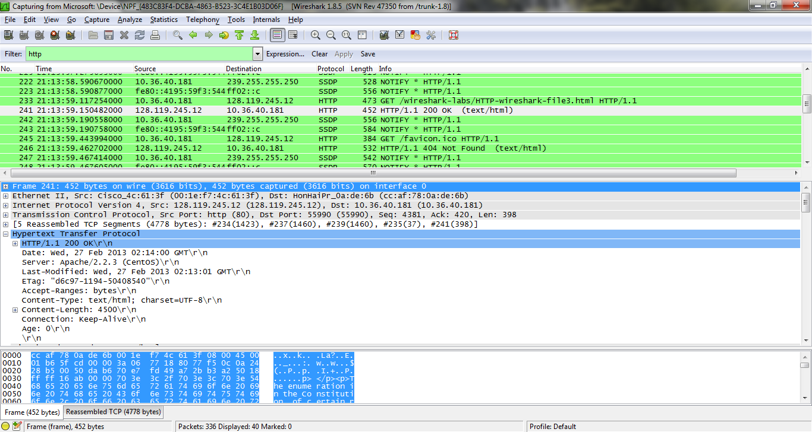
COMPUTER NETWORKS
HTTP Response Message – Wireshark Capture

Slide 10
COMPUTER NETWORKS
HTTP Response Status Codes
status code appears in 1st line in server-to-client response message.
some sample codes:
200 OK
request succeeded, requested object later in this message
301 Moved Permanently
requested object moved, new location specified later in this message (in Location: field)
400 Bad Request
request msg not understood by server
404 Not Found
requested document not found on this server
505 HTTP Version Not Supported

Slide 11
COMPUTER NETWORKS
Application Layer
Sivaraman Eswaran Ph.D.
Department of Computer Science and Engineering

Slide 12
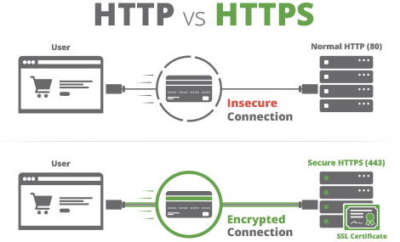
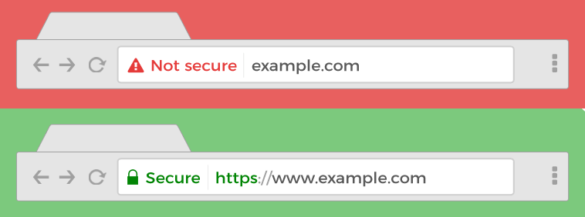
COMPUTER NETWORKS
HTTP vs HTTPS
HTTPS is HTTP with encryption – All communications between browser and server are encrypted (bi-directional).
‘S’ refers ‘Secure’ or HTTP over Secure Socket Layer.
Uses TLS (SSL) to encrypt normal HTTP requests and responses.
Attackers can't read the data crossing the wire and you know you are talking to the server you think you are talking too.

Slide 13
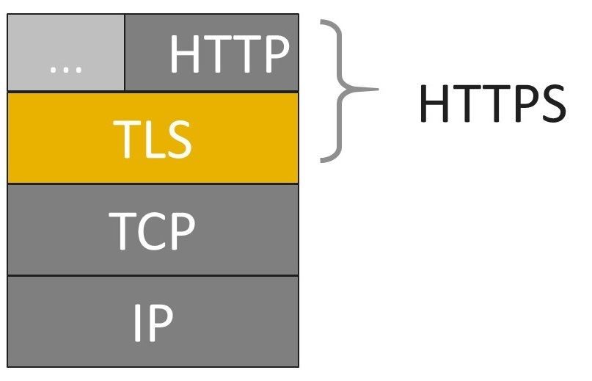
COMPUTER NETWORKS
HTTP vs HTTPS (more)
HTTP + TLS -> Encrypted
Uses port no. 443 for data communication.
HTTPS is based on public/private-key cryptography.
The public key is used for encryption
The secret private key is required for decryption.
SSL certificate is a web server’s digital certificate issued by a third party CA.
Create an encrypted connection and establish trust.
Is my certificate SSL or TLS?
Any message encrypted with Bob’s public key can be only decrypted with Bob’s private key.

Slide 14
COMPUTER NETWORKS
How does SSL works?
Step 1: Browser requests secure pages (HTTPS) from a server.
Step 2: Server sends its public key with its SSL certificate (digitally signed by a third party – CA).
Step 3: On receipt of certificate, browser verifies issuer’s digital signature. (green padlock key)
Step 4: Browser creates a symmetric key (shared key), keeps one and gives a copy to server. Encrypts it using server’s public key.
Step 5: On receipt of encrypted secret key, decrypts it using its private key and gets browser’s secret key.
Asymmetric and Symmetric key algorithms work together.
Asymmetric key algorithm – verify identity of the owner & its public key -> Establish trust.
Once connection is established, Symmetric key algorithm is used to encrypt and decrypt the traffic.

Slide 15
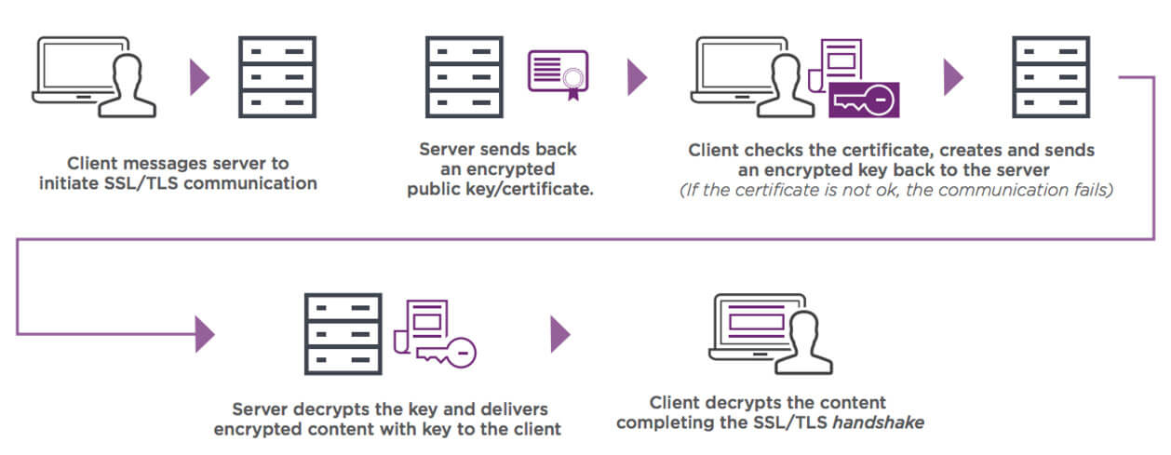
COMPUTER NETWORKS
How does SSL works?

Slide 16

COMPUTER NETWORKS
Benefits of HTTPS over HTTP using SSL Certificates
Stronger Google ranking.
Updated browser labels.
Improved security.
Increased customer confidence / safer experience.
Build customer trust and improve conversions.

Slide 17
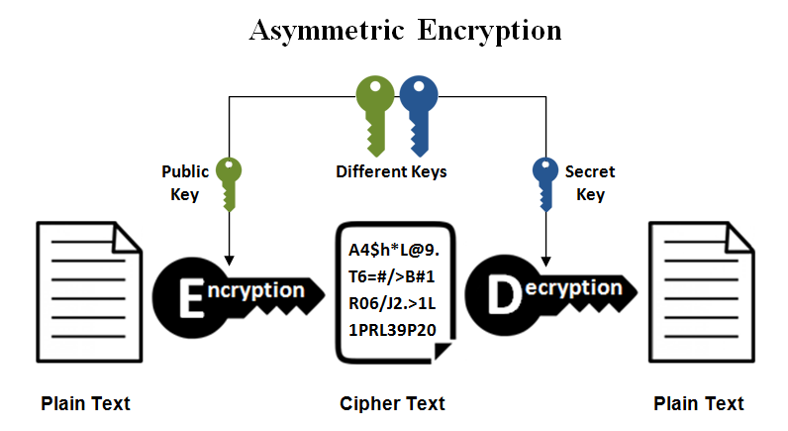
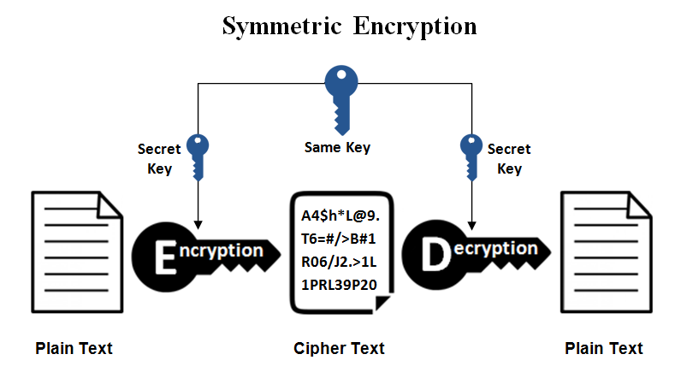

Slide 18
THANK YOU
Sivaraman Eswaran Ph.D.
Department of Computer Science and Engineering
sivaramane@pes.edu
+91 80 6666 3333 Extn 834

